Slide 1
Methodology
Dr. Arif Mahmud
Associate Professor & Associate Head
Department of CSE, Daffodil International University

Slide 2
Definition
Schwardt (2007:195) defines research methodology as a theory of how an inquiry should proceed. It involves analysis of the assumptions, principles and procedures in a particular approach to inquiry. According to Creswell and Tashakkori (2007), and Teddlie and Tashakkori (2007), methodologies explicate and define the kinds of problems that are worth investigating; what constitutes a researchable problem; testable hypotheses; how to frame a problem in such a way that it can be investigated using particular designs and procedures; and how to select and develop appropriate means of collecting data.

Slide 3
Methodology
It is the part of the proposal or research paper that describes the methods used to collect the data
It follows the introduction and literature review
It allows the reader to understand how the data were analyzed, and to judge for himself if the methods were justified
It should be detailed enough for a good researcher to be able to replicate the study from reading the method section

Slide 4
Methodology sections
Participants: Who was in the study
Procedure: What happened in the study
Measures/Materials: What measures were used—like surveys Or what materials—like special lab equipment
Analysis section: Describes the statistical analysis

Slide 5
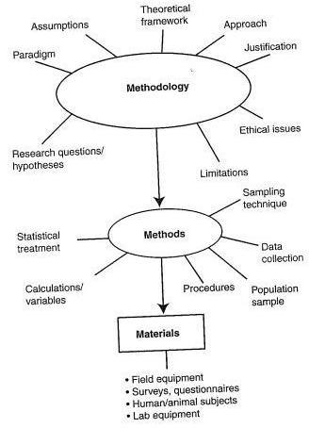
Process

Slide 6
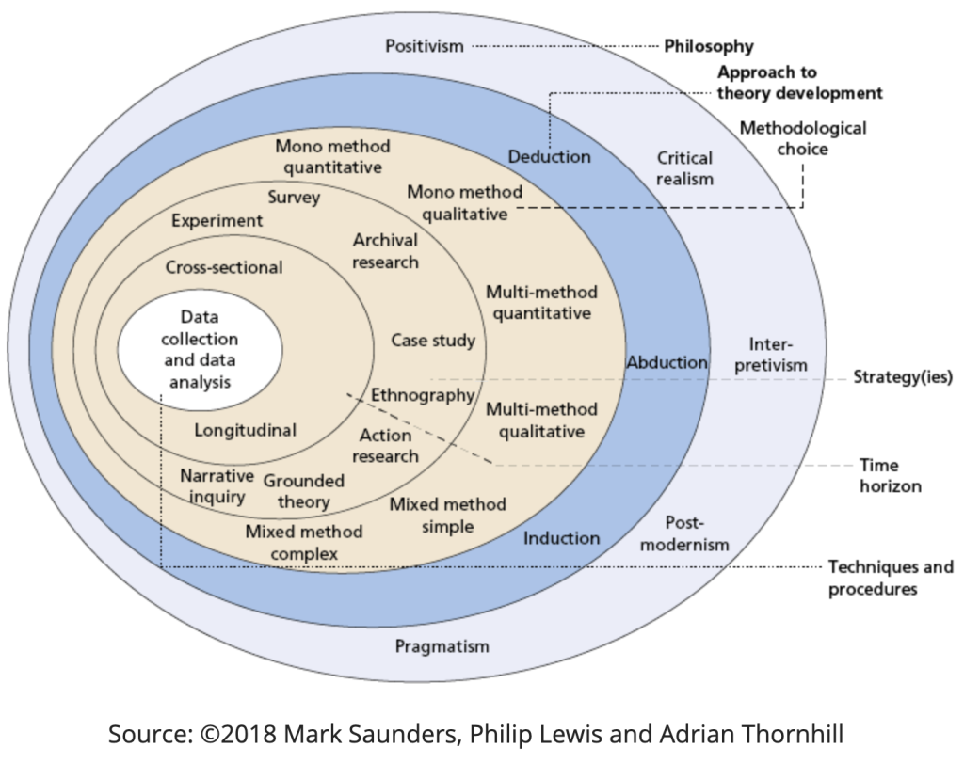
Approach

Slide 7
To include
An outline of the research methods chosen (qualitative, quantitative, or mixed methods)
Background and rationale for the methods chosen, explaining why one method was chosen over another
Methods used for data collection and data analysis
Materials and equipment used—keep this brief
Difficulties encountered during data collection and analysis.
A brief evaluation of your research explaining whether your results were conclusive and whether your choice of methodology was effective in practice

Slide 8
To avoid
Irrelevant details, for example, an extensive review of methodologies (this belongs in the literature review section) or information that does not contribute to the readers’ understanding of your chosen methods
A description of basic procedures
Excessive details about materials and equipment used. If an extremely long and detailed list is necessary, add it as an appendix
Raw data

Slide 9
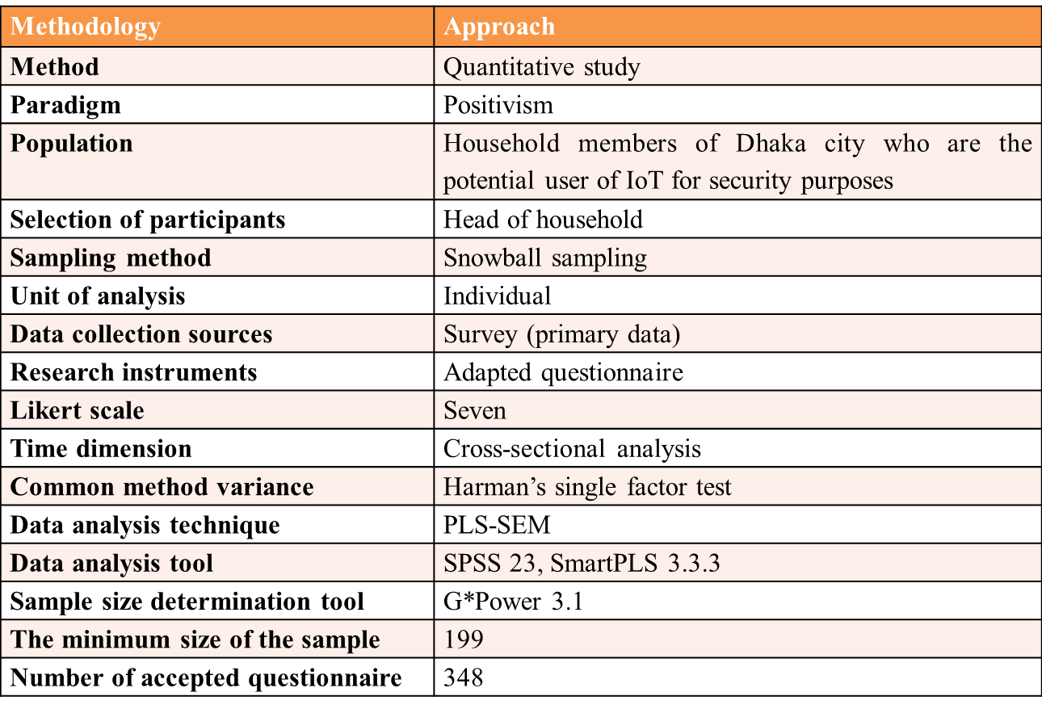
Summary

Slide 10
Checklist
Introduce your methodological approach, for example, quantitative, qualitative, or mixed methods.
Explain why your chosen approach is relevant to the overall research design and how it links with your thesis question.
Justify your chosen method and why it is more appropriate than others.
Provide background information on methods that may be unfamiliar to readers of your thesis.
Introduce the tools that you will use for data collection, and explain how you plan to use them (e.g., surveys, interviews, experiments, or existing data).
Explain how you will analyze your results. The type of analysis used depends on the methods you chose. For example, exploring theoretical perspectives to support your explanation of observed behaviors in a qualitative study or using statistical analyses in a quantitative study.
Mention any research limitations. Discussing the limitations justifies your choice of methodology despite the risks. It also explains under which conditions the results should be interpreted and shows that you have taken a holistic approach to your study.

Slide 11
Further reading
Sekaran, U. (2003). Research methods for business: A skill-building approach (4th ed.). New York: John Wiley & Sons.
Bhattacherjee, A. (2012). Social science research: Principles, methods, and practices (2nd ed.). University of South Florida: Creative Commons Attribution. Retrieved from https://scholarcommons.usf.edu/cgi/viewcontent.cgi?article=1002&context=oa_textbooks
Bryman, A. (2012). Social Research Methods (4th ed.), New York: Oxford University Press.
Creswell, J. W. (2014). Research Design: Qualitative, Quantitative and Mixed Methods Approaches (4th ed.). Thousand Oaks, California: Sage.

Slide 12

The End
Thank You

